Slide 1
Claims, aka WOW, didn’t see that coming
2021 OLTA Educational Seminar
October 14, 2021 (noon)
Presented by
David Green, V.P.
Underwriter / Legal Counsel
Fidelity National Title Group
David.Green@ctt.com
and
Ian Kyle
Underwriting Counsel
Old Republic Title
ikyle@ortc.com

Slide 2
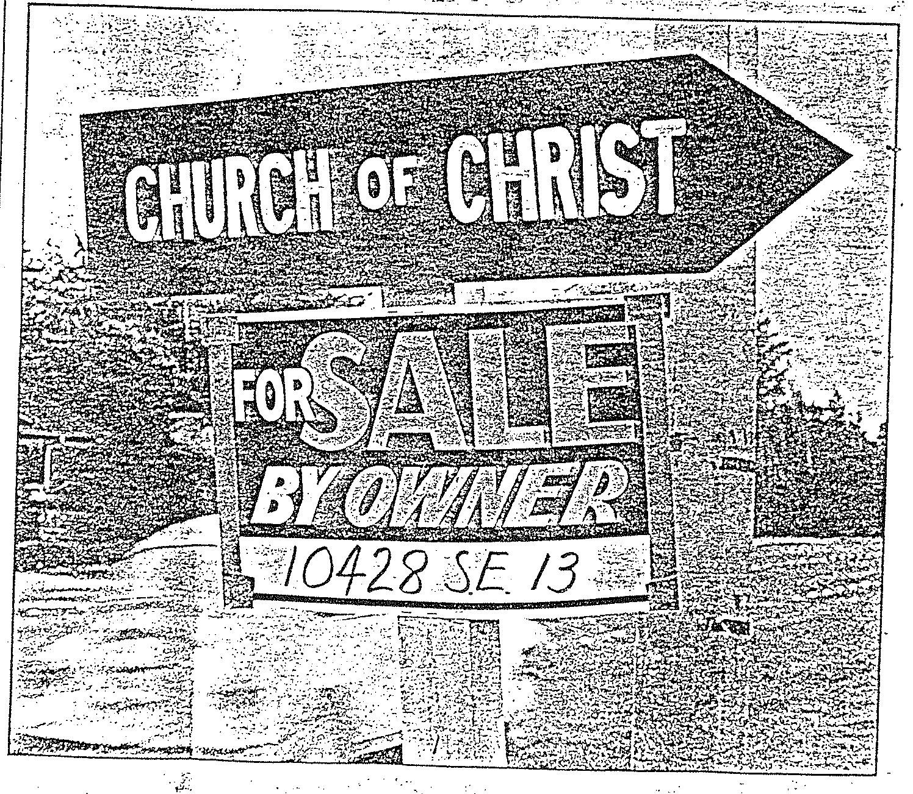
Notes:
This is a picture that appeared in the Oregonian.
The juxtaposition of these two signs would lead one to believe that one could probably expect a risk-free purchase. Certainly, you would expect the deed to be good.
But in a normal transaction, even between friends and relatives, there is, understandably, concern about the state of the property’s title.

Slide 3
What can a buyer or lender do to confirm title?
Ask Around
Go to Courthouse or go online
Notes:
What can a buyer or lender do to assure that the title they are acquiring or that is securing a loan is what they expect and in the condition they expect?
Click
They can ask around. They can ask the seller and neighbors and others. This is what was done in medieval times with mixed results.
Click
Because we now have filed written documents, you could go to the courthouse or on line and try to find and read and interpret the effect of documents found there (assuming you have the expertise to do so).

Slide 4
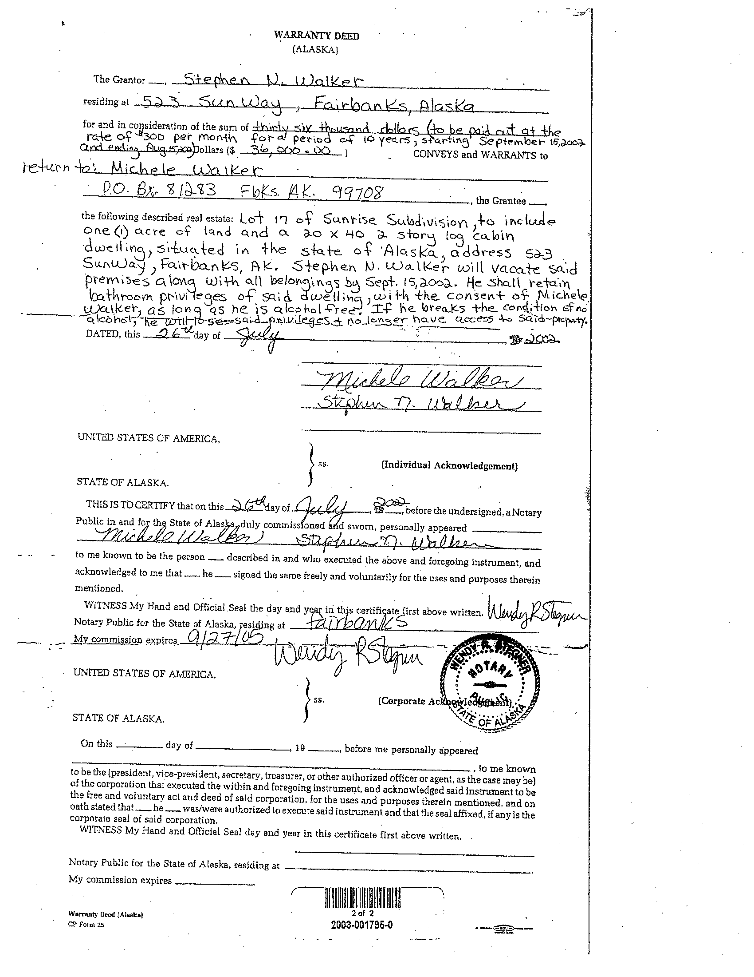
He shall retain bathroom privileges of said dwelling, with the consent of Michelle, as long as he is alcohol free. If he breaks the condition of no alcohol, he will lose said privileges & no longer have access to said property.
Stephen will vacate said premises along with all belongings by September 15.
Notes:
What if something like this is found – this is one of our favorite Alaska deeds. This is a warranty deed from Stephen Walker to Michelle Walker. Consideration is $36,000 to be paid at a rate of $300 per month over 10 years. (So is that an installment contract or mortgage?)
Click
Stephan is to vacate the premises by a certain date.
Click
But … “He shall retain bathroom privileges of said dwelling, with the consent of Michelle, as long as he is alcohol free. If he breaks the condition of no alcohol, he will lose said privileges and no longer have access to said property.”
What do you do with that? Is some future owner going to be watching TV some evening when Mr. Walker walks by on his way to the bathroom?

Slide 5
What can a buyer or lender do?
Ask Around
Go to Courthouse
Abstract of Title
Attorney Opinions
Title Insurance
Notes:
So what else can a buyer or lender do?
Click
There are professionals that can provide and abstract of title and
Click
An attorney can provide an opinion concerning the status of title.
Click
Or, as everyone knows, you can get title insurance. One of the problems with all the other alternatives is that there is either no recourse if the title turns out to be not as represented or your only recourse is a lawsuit for recovery of damages. You would have to sue a title abstractor for the tort of negligence. You would have sue an attorney for negligence or malpractice.

Slide 6
Trade off of tort liability (negligence) for –
A Contract
Deep Pockets
Claims Handling
Notes:
With title insurance –
Click
There is a contract that spells out the title insurers liability
Click
the insured can be sure that the title insurance company has the ability to pay any loss
Click
And title insurance companies have claims departments that the insured can contact. They have a claims staff who will respond and who will investigate, fix title defects, defend against attacks on the insured’s title and settle claims. This ability to make a claim or tender a defense under a title insurance policy is a very important part of the value of title insurance.

Slide 7
Claims Basics
An Insured has a Claim against their Policy if:
  A title defect or lien that implicates one of the Policy’s Insuring Provisions,
  Prior in time to the Effective Date of the Policy, and
  There is no Exception or Exclusion for this defect or lien in the Policy
  Claim Losses are those amounts expended by the Company to make the Insured whole.
  Claim EXPENSES are those additional costs incurred in administration of the Claim, and those are just as much a LOSS to the Company.
  Dave’s Rule of Thumb – If there is any title question that might need to be resolved in court, even if the law is strongly on our side, that is too large a risk (will the party potentially claiming against our Insured survive a Motion to Dismiss?).

Slide 8
Claim v. Liability
“My client fell off the stairs of her new house because the banister was too low. You insured her new house.”
Notes:
Speaking of claims – First, there is a difference between a claim against a policy and liability under a policy. Claims departments receive claims all the time for matters that just do not fall within policy coverage. This one and the others we will talk about today are real claims.
Click
My client fell down the stairs in her new house because the banister was too low. You insured her new house.
It was of course denied but the insured lawyer actually filed a suit against the title company for denying coverage. The attorney finally saw the light and dismissed the suit under threat of a motion for sanctions against her and her client for filing a frivolous lawsuit.

Slide 9
“My neighbor throws empty whiskey bottles into my backyard from his bedroom window.”
Notes:
Or how about this one that was was also a real claim. Any liability? Neighbor must not have shared.

Slide 10
Notes:
As was this…from a neighbor who did not like the condition of his neighbor’s fence!

Slide 11

2020
State of Oregon
Title Premiums
$367,136,962
Notes:
So how are we doing in Oregon? The latest figures for a full year are for 2020.
Click
The amount of title insurance premiums collected by all companies in Oregon in 2016 was $367,136,962.
Prior year (2019) was $118M less! Any ideas why? (refinances maybe?)

Slide 12
2020
State of Oregon
Paid Policy Losses
$3,237,333
Notes:
Click
The amount paid policy losses was only $3,237,333. The percentage of loss paid in 2020 compared to Premiums is under 1%. Any underwriter will tell you that is a very good number – anything in the 3 to 3.5% range is really good. So we are doing a good job here in Oregon.

Slide 13
2020
State of Oregon
Paid Escrow Losses
?
Notes:
Click
How much was paid in escrow losses?
We do not have those figures. They are not shared by companies.

Slide 14
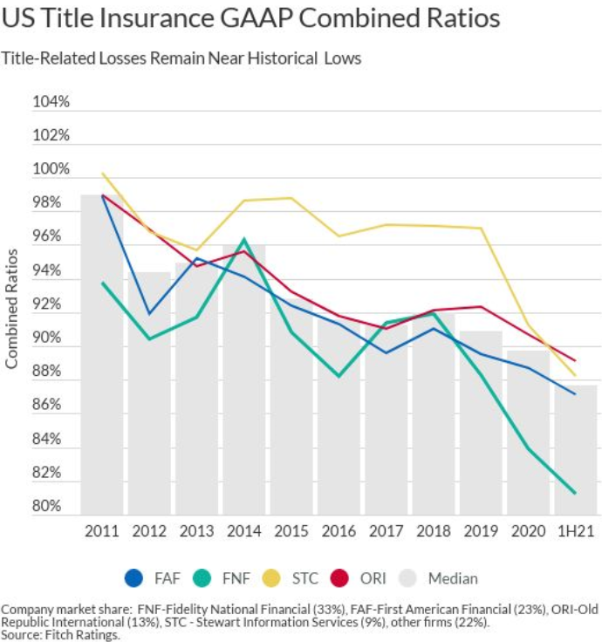
Notes:
Our state follows a nationwide trend. See here.
GAAP Combined Ratio: Underwriter profitability. There are several components in the ratio but losses (paid claims) is one of them.
In general, below 100% means financial profit; above 100% means loss.
Correlation between economic conditions and claims.

Slide 15
Mechanics Liens
Canary in the Coal Mine
Construction Liens are cyclical with housing crashes.
No good trick to predict who or when, just know your builder customers’ financials.
Where you see one, you will see more.
Leading Indicators – A local builder who is financing the next project by taking equity from current incomplete project. A fine line between smart business and overloading debt.

Slide 16
Who caused the claim?
Notes:
This is one of the thing you can count on.
When there is a claim people will become nervous and wonder who is at fault. People seem to always point fingers…

Slide 17
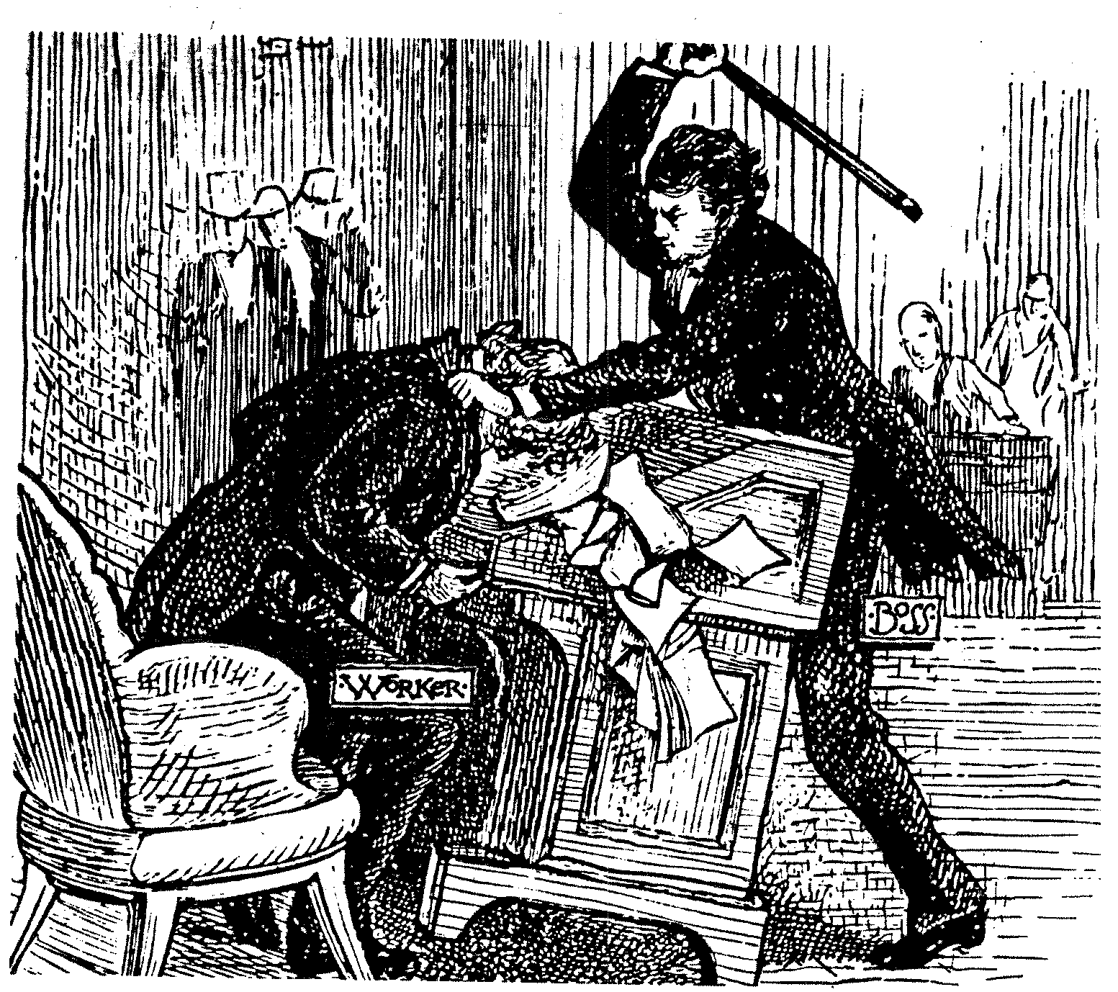
Notes:
How it can feel, as a worker.

Slide 18
Who caused the claim?
Escrow
Title
Escrow and Title
Customer Service
Word Processing
Sales
Underwriter / Decision Maker
Notes:
Who caused the claim?
Click and read the seven choices. ( I would like to think that would never happen!)
Obviously, we should all try to limit claims as best we can. Not just for the sake of our companies but for the sake of our customers. No one wants to make a claim on their title insurance policy. Our insureds expect to never have to look at their policy after closing and that is what we want too. The fact is though that claims happen. You have heard this many times: This is an insurance business. Not all claims are caused by someone’s mistake but even if a mistake was made, it is understood that we are all under tremendous pressure to produce a high volume of work flawlessly as we face new and various challenges every day.
Following is a description of a real claim. See if you can tell who made the mistake..

Slide 19
Claim No. 1
The case of the
Dead Woman Walking

Slide 20
The Players
Dorothy Applewyte, deceased
Buyers
I DON’T KNOW WHAT MOM OWNED.
I’LL ASK A REAL ESTATE AGENT
I’LL CHECK WITH TITLE CO. CUSTOMER SERVICE.
Escrow
Son - PR
Title
Probate Attorney
Customer Service
Real Estate Agent
Notes:
Margaret Dorothy Applewyte, who regularly went by her middle name Dorothy, was known to own several properties in Oregon;
Click
but when she died her son, who was from California, had no idea what properties she had actually owned .
A probate was filed and her son was named Personal Representative of her estate.
Click
The attorney for the estate told the son that he knew a local real estate agent whom he thought might be familiar with the properties that the deceased had acquired over the years.
The real estate agent was familiar with Ms. Applewyte and could identify many of the properties in the county that made up her estate, but the agent suspected that Ms. Applewyte might have also owned some properties in the neighboring county.
Click
The agent told the PR that she would check with customer service at the title company.
Click
Click
The agent contacted the customer service department of a title company in the neighboring county and asked if they could find any deeds to a Margaret Applewyte or a Dorothy Applewyte.
Click

Slide 21
The Players
Dorothy Applewyte, deceased
Buyers
DOES DOROTHY APPLEWYTE OWN ANYTHING?
WE FOUND A DEED TO DOROTHY M. APPLEWYTE.
Escrow
Son - PR
Title
Probate attorney
Customer Service
Real Estate saleswoman
Notes:
After doing some research, the employee in customer service told the agent that there was a deed to a Dorothy M. Applewyte. The agent asked the customer service employee to send a copy of the deed to him. The agent then, in turn, provided the deed, among others, to the probate attorney.

Slide 22
The property was a beautiful vacant lot -perfect for building a house.
PR listed the property with the real estate agent.
Real estate agent sold to buyers - $86,000.
Title and escrow placed with title company.
Notes:
The property was a beautiful vacant lot -perfect for building a house.
Click
The PR and the attorney then hired the real estate agent to sell the various properties that made up the estate including the property in the next county.
Click
The property quickly sold to buyers that planned to build a new house for their family.
Click
An order for title insurance and escrow is placed with the title company.

Slide 23
The Players
Don’t be ridiculous I am handling it. Here is the paperwork.
The property is on the inventory. Her son is PR.
Dorothy Applewyte, deceased
We do not find a probate for Dorothy M. Applewyte.
Buyers
Escrow
Son - PR
Title
Probate attorney
Customer Service
Real Estate saleswoman
Notes:
Click
Click
The title company then contacted the parties stating that they could not find a probate proceeding for a Dorothy M. Applewyte or anything else that showed that she was deceased.
Click
This prompted a rather indignant call from the probate attorney who informed the title company that of course she was deceased and that he was handling the probate for Margaret Dorothy Applewyte and that she was the same person as Dorothy M. Applewyte. He then sent probate pleadings to the title company that showed the property as part of the inventory listed in the probate.

Slide 24
The transaction was closed and a policy issued insuring the buyers to $86,000. The buyers then began construction on their new house.
Notes:
The transaction was closed and a policy issued insuring the buyers for $86,000. The buyers then began construction on their new house.

Slide 25
Meanwhile in a land far, far away…

Slide 26

Notes:
Dorothy M. Applewyte was hosting a family reunion. At some point it was decided that she and several of her relatives would all travel to view Dorothy’s beautiful property where she would soon be building her dream house.

Slide 27
But when Dorothy and her relatives arrive at her dream property…
Notes:
But when Dorothy and her relatives arrived at her dream property they find that construction had begun on someone else’s dream home! Yes, Dorothy M. Applewyte is the true owner. Margaret Dorothy Applewyte never had an interest in the property. The insured buyers do not have title to the property. This is a real mess. Whose fault is it?

Slide 28
What happened here?
Dorothy M. Applewyte (in title)
≠
Margaret Dorothy Applewyte (deceased)
Notes:
Title to the property was held by Dorothy M. Applewyte (the rumors of her death had been greatly exaggerated).
The decedent was Margaret Dorothy Applewyte.

Slide 29
The Players
M. Dorothy Applewyte, deceased
Buyers
Escrow
Son - PR
Title
Probate Attorney
Customer Service
Real Estate Agent
Notes:
The buyers have title insurance coverage up to $86,000, but because they have a house half built, they are in a position to lose much more. So what do they do? They sue the PR of the estate who sold them the property and they also sue the real estate agent.
Click
The PR holds the attorney responsible.
Click
The attorney blames the real estate agent and (Click) the title company for providing a “defective” commitment and policy and (Click) the title company’s customer service department for providing “incorrect” information.
Click
The agent blames title company’s customer service department and (Click) the title company in general because of the commitment and policy.
Click
Because the title company is subrogated under the terms of the policy to the claims of the insured buyers against the seller, it has an action against the PR.

Slide 30
Solution
Dorothy found a new and better (more expensive) lot.
Everyone (some reluctantly) contributed to the purchase of the new lot except…
The real estate agent who kept the commission.
Notes:
This is what happened in the end.
Click
Dorothy – the alive and well Dorothy - found a new and better ( and of course more expensive) lot.
Click
Everyone (some reluctantly) contributed to the purchase of the new lot except…
Click
The real estate agent who kept the commission.

Slide 31
LESSON
We are all human and humans make mistakes.
Sometimes it’s a group effort.
Notes:
What is the Lesson here?
CLICK
We are all human and humans make mistakes.
Click
And sometimes it’s just a group effort….

Slide 32
Unreleased HELOCs
Ten years ago, unreleased or unsubordinated HELOCs represented about 25% of Lender Policy claims.
Deutsche Bank Nat'l Tr. Co. v. E*Trade Bank, No. A150279, 2018 WL 5023611 (Cal. Ct. App. Oct. 17, 2018)
  If a HELOC is paid to zero, and the borrower sells the property, the HELOC cannot be enforced against the new owner of the property.
  Equitable ruling that makes situation more fair, but it is still CRITICAL that any HELOC being closed have the proper authorization to close signed by the borrower.

Slide 33
Claim No. 2
The case of the
Japanese Divorce

Slide 34
Title company was asked to insure a sale of a medical building for $5 million.
Two years after the transaction closed the county court entered a judgment that resulted in a complete failure of the insureds’ title.
Neither the title company nor the insureds knew anything about a court action before being informed of the judgment.
How could this happen?
Notes:
The title company was asked to insure a sale of a medical building for $5 million.
Click
Two years after the transaction closed there was a judgment entered that resulted in a complete failure of the insureds’ title.
Click
Neither the title company or the insureds knew anything about a court action before being informed of the judgment.
Click
How could this happen?

Slide 35
What we discovered.
Notes:
What we discovered.

Slide 36
Mr. and Mrs. A were Japanese citizens.
Mrs. A introduced her husband to Mr. B who had some ideas regarding investment in the U.S.
Notes:
Mr. and Mrs. A were Japanese citizens.
Click
Mrs. A introduced her husband to Mr. B who had some ideas regarding investment in the U.S.

Slide 37
Mrs. A and Mr. B went to Washington State to invest.
Notes:
Mrs. A and Mr. B went to Washington State without Mr A to invest some of their “hard earned money”.

Slide 38
Mr. and Mrs. A and Mr. B formed a corporation with Mrs. A in charge.
The corporation bought Washington properties including the subject commercial/medical building.
Notes:
Mr. and Mrs. A and Mr. B formed a corporation with Mrs. A in charge.
Click
The corporation bought Washington Properties including this commercial/medical building.

Slide 39
Things you should know (that we found out later) -
Mrs. A and Mr. B were more than just business partners.
Mrs. A and Mr. B are stealing from Mr. A.
Mr. A found out.
Notes:
Things you should know (that we found out later) –
Click
Mrs. A and Mr. B are more than just business partners.
Click
Not only are they a “little more” than business partners, Mrs. A and Mr. B are stealing from Mr. A.
Click
Mr. A found out.

Slide 40
Lawsuit is filed
Lis Pendens Recorded
King County Case Put “On Hold”
KING COUNTY SUPERIOR COURT
TOKYO DIVORCE COURT
Notes:
A lawsuit is filed by Mr. A in King County, Washington Superior Court against Mrs. A, Mr. B and the corporation. A lis pendens was recorded.
Mr. A also filed for divorce in Tokyo. There were a lot of assets that were in dispute in the divorce including the King County property.
Click
So the attorneys here decided to put its case on hold in deference to the Tokyo Divorce Court. Once the divorce matters were cleared up then the King County case would resume.

Slide 41
Mr. A Died
Mr. A’s Relatives took over
TOKYO DIVORCE COURT
TOKYO DIVORCE COURT
Notes:
As the divorce case proceeded
Click
Mr. A passed away.
Click
His relatives, as his heirs, then stepped in to argue about the assets.

Slide 42
7 years pass since the action was filed in Washington…
During that time Mrs. A has transferred title of the medical building to her own corporation and then sold the property for $5 million.
Title is insured free of any mention of litigation.
Notes:
7 years passed since the court action had been filed in Washington.
During that time Mrs. A kept pressing forward. She still had the corporate authority for the company that owned the medical building.
Click
While the action in Japan proceeded, Mrs. A transferred, (in an uninsured transaction) the ownership of the medical building to a Company wholly owned by her. Subsequently she sold the property for $5 million.
Click
This was the transaction insured by the title company. Title is insured free and clear of any mention of litigation

Slide 43
The title examiner ignored the lis pendens since it was 7 years old and the property had been transferred to “new” ownership.
Notes:
Remember, a lis pendens had been recorded providing notice of the Washington court case. But the examiner ignored the lis pendens because it was so old. Even if the examiner had looked into the case, the docket would show that nothing had happened in the suit for 7 years.

Slide 44
Mr. A’s Relatives eventually won in the Japanese court
TOKYO DIVORCE COURT
Notes:
Mr. A’s Relatives eventually won in the Japanese court

Slide 45
Back to KCSC where title is quieted in Mr. A’s relatives.
KING COUNTY SUPERIOR COURT
Total Failure of Title
Notes:
The Washington court then followed with its decision that title to the medical building was held by Mr. A’s heirs. Neither the title company or the insured “owners” knew about the court proceedings until after the decision. There was no duty on the part of the parties to the court proceeding to serve or notify the insureds, who were subsequent in time. The action had commenced prior to their purchase and a lis pendens had been recorded. They did not have to be named as parties to the suit.
The result Click
Total failure of title

Slide 46
Result
Thanks to effort by the claims department and attorneys hired to protect the insureds, the insureds were able to keep the property and the title company did not lose $5 million.
It lost under $2 million plus $900,000 in attorney’s fees.
It turned out that some of the relatives were not as innocent as initially claimed.
Notes:
How did this turn out?
Click
Thanks to effort by the claims department and attorneys hired to protect the insureds, the insureds were able to keep the property and the title company did not lose $5 million.
Click
However, it lost a little under $2 million plus $900,000 in attorney’s fees.
Click
Why did the heirs settle? A little research showed that that some of the relatives were not as innocent as they initially claimed - they knew what was going on
NEXT: We all have files that we affectionately refer to as dog files…..

Slide 47
Real claims caused by real dogs.

Slide 48
“Why are you blocking my policyholder’s access easement?”
“Because his dog walks in the easement area and the easement area is not for dogs.”
Notes:
The claims attorney asked the neighbor: Why are you blocking my policyholder’s access easement?
Click
Because his dog walks in the easement area and the easement area is not for dogs.

Slide 49

“Your insured’s dog urinates on my flowers in the easement area.”
he he he
Notes:
Or this one: Your insured’s dog urinates on my flowers in the easement area.
Click
Why is this dog laughing? – yes because he is the culprit….

Slide 50
Government and NGO 2nd Mortgages
There are many housing assistance programs, both government sponsored and charity sponsored (Habitat for Humanity), where the organization places a second mortgage. Sometimes it is a small amount, sometimes it is the same amount as the first mortgage. The second mortgage is usually more about making sure the homeowner complies with the program than getting money paid back.
There are many claims where the second mortgage was not properly released, usually because a title or escrow officer did not believe release was necessary because no payoff was due.
Foreclosure also requires notice to the second mortgage holder, and failure to do so properly results in numerous claims.

Slide 51
Claim No. 3
The case of the
Family Plot

Slide 52
John Sanky Overtrot
John Sanky Overtrot
John Sanky Overtrot
Notes:
This claim involved, among others, three parties that had the exact same first, middle and last names – John Sanky Overtrot, John Sanky Overtrot and John Sanky Overtrot

Slide 53
The Overtrots
John Sanky Overtrot (Grandfather)
John Sanky Overtrot Jr. (the son)
John Sanky Overtrot III (the grandson)
Notes:
Who were the Overtrots?
Although they never refered to themselves as such, we will identify them as:
Click
Grandfather
Click
The son, and
Click
The Third, or grandson

Slide 54
The Story
John the grandfather inherited some land from his mother.
He decided to sell the land to buyers that were going to develop it.
John, the grandfather, and the buyers applied for title insurance and escrow services with the title company.
Notes:
So here’s the story:
Click
John the grandfather inherited some land from his mother.
Click
He decided to sell the land to buyers that were going to develop it.
Click
John, the grandfather along with the buyers applied for title insurance and escrow services with the title company.

Slide 55
Things that you should know about John, the grandfather
He told title and escrow that he was not married.
He had worked as a rodeo clown and did not have much money – he did not even have a bank account.
Notes:
Things that you should know about John, the grandfather
Click
He told title and escrow that he was not married.
Click
He told the title company that he had worked as a rodeo clown and did not have much money – he didn’t even have a bank account.

Slide 56

When the sale closed he was given a check for over $2 million dollars.
He left the title company looking for a bank.
Notes:
When the sale closed he was given a check for over $2 million dollars.
Click
He left the title company and went looking for a bank.

Slide 57
Within an hour a woman arrived at the title company accompanied by a young man.
The woman claimed to be John the grandfather’s wife. Grandfather later said he forgot that he was married because they had not lived together for over 20 years.
The young man was John III, the grandson.
Both claimed that they held an interest in the property or, more importantly to the wife, an interest in the $2 million.
A stop payment was put on the check.
Notes:
Within an hour after closing, a woman showed up at the title company accompanied by a young man.
Click
The woman claimed to be John the grandfather’s wife. Grandfather later said he forgot that he was married because they had not lived together for over 20 years.
Click
The young man was John III, the grandson.
Click
Both claimed that they held an interest in the property or, more importantly to the wife, an interest in the $2 million that grandpa had just put in his pocket.
Click
So a stop payment was put on the check.

Slide 58
John Jr.
Sometime later John Jr. claimed that he owned half of the property because he had a letter from John the grandfather’s now deceased mother that stated that, upon her death, one half of the property was to go to John Jr. Unfortunately for John Jr., her will did not say that.
Notes:
Sometime later John Jr. claimed that he owned half of the property because he had a letter from John the grandfather’s now deceased mother (his great –grandmother) that stated that, upon her death, one half of the property was to go to John Jr. Unfortunately for John Jr., her will did not say that.

Slide 59
Things you should know about John Jr.
John Jr. was, and still is, incarcerated in the state penitentiary.
He is serving a sentence for murder.
He killed his girlfriend’s husband because the husband had accused him of molesting their daughter.
During the title company’s later investigation, John Jr.’s sister stated that John Jr. was in fact a child molester and that she would shoot him on sight if he ever came near her family.
Notes:
Things you should know about John Jr.
Click
John Jr. was, and still is, incarcerated in the state penitentiary.
Click
He is serving a sentence for murder.
Click
He killed his girlfriend’s husband because the husband had accused him of molesting their daughter.
Click
John Jr.’s sister stated that John Jr. was in fact a child molester and that she would shoot him on sight if he ever came near her family. (We were dealing with a nice normal family…)

Slide 60
Things you should know about John III
John the grandson was unemployed.
At the time of the sale John III actually lived on the property in a camping trailer.
Notes:
Things you should know about John III
Click
John the grandson was unemployed.
Click
At the time of the sale John III actually lived on the property in a camping trailer.

Slide 61
The lawsuit begins …
Notes:
The lawsuit begins

Slide 62

The Players
John the grandfather
Grandfather’s spouse
John the son
The Title Company
John the grandson
The buyers
Notes:
John, the son, who had lots of time on his hands to pursue litigation, Click sued his father (the grandfather) for selling the property (Click) and sued the title company for the money that the company was still holding.
Click
The Grandfather’s wife sued the title company for the money.
Click
She also sued the buyers claiming that she held some interest in the title to the property. This, in turn, resulted in a tender of defense to the title company under the terms of the policy.
Click
John the Grandson sued the buyers for the following reason:

Slide 63
Notes:
Remember John the grandson lived on the property at the time of the sale. While he was away from home, the buyers in an apparent hurry to clear the land for development destroyed the grandson’s trailer.

Slide 64
Notes:
As John the grandson testified in court –
Click
the buyers crushed his trailer with all his belongings inside and threw it into a dumpster.

Slide 65
What else you need to know about the buyers. (What was discovered in litigation.)
They had originally taken the transaction to Brand X title company.
Brand X was contacted by all the parties – spouse, son, grandson – and were informed of their claims, so….
The buyers moved title and escrow and did not inform the closing title company about any of the claims.
Notes:
What else you need to know about the buyers. (What was discovered in litigation.)
Click
They had originally taken the transaction to Brand X title company.
Click
Brand X was contacted by all the parties – spouse, son, grandson – and were informed of their claims, so….
Click
The buyers moved title and escrow and did not tell the closing title company about any of the claims.

Slide 66
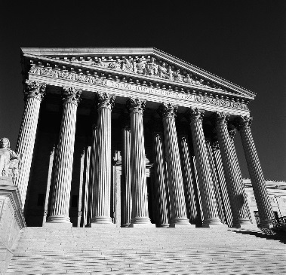
The Players
John the grandfather
Grandfather’s spouse
John the son
The Title Company
John the grandson
The buyers
Notes:
Title insurance policies exclude adverse claims or other matters not known to the title company, not recorded in the public records but known to the insureds prior to the date of the policy and not disclosed to the title company. The buyers clearly knew of the claims of the parties but did not tell the closing title company. Once this was discovered by the title company, the insureds’ tender under the policy for the claims of Grandfather’s wife was denied.
Click.
In case you are wondering, public records means real estate records under the policy definition – not marriage records.
After the denial the only claims against the title company that remained were really for the sale proceeds that it still held.
Click
So the title company disclaimed any interest in the proceeds and deposited the money with the court.
Click
The claims of John, the son, and Grandfather’s wife then followed the money.

Slide 67
Result
The title company was dismissed from the lawsuit and the claim against the policy was denied.
We do not know the final outcome of all the claims but we understand that John the grandfather died before the litigation was complete and he never got to enjoy his money.
Notes:
The Result
Click
The title company was dismissed from the lawsuit and the claim against the policy was denied.
Click
We do not know the final outcome of all the claims but we understand that John the grandfather died before the litigation was complete and he never got to enjoy his money.

Slide 68
Sometimes it is just the people we are dealing with.
Notes:
Sometimes it is just the people you are dealing with.

Slide 69

Your insured purposely spins his tires to throw gravel at my house.
Notes:
Another real claim.

Slide 70
What new Frauds are we seeing in California?
Equity Skimming Scheme
  Fraudster group finds homeowner mark, often elderly or immigrant
  Homeowner grants title to Fraudster who allows homeowner to live in house for little or no rent
  Fraudster places “private equity” DOT on property in amount of remaining equity, in the name of an LLC that Fraudster controls.
  Fraudster gets a legitimate refinance loan for the payoff of both existing DOTs.
  Fraudster takes payoff of private equity DOT and disappears.

Slide 71
What new Frauds are we seeing in California?
ID Theft
  Fraudster identifies a property that is behind on taxes, usually undeveloped land
  Wait for actual owner of the land to go out of town
  Fraudster impersonates owner and sells land for “major discount”
  Actual owner returns to his land to find someone is building a house there

Slide 72
Claim No. 4
The case of the
Greedy Granny
Notes:
Claim No 4: The case of the greedy Granny
Click

Slide 73
David and Edith Ellison were successful commercial Realtors in Arizona
Notes:
David and Edith Ellison were successful commercial realtors/developers/landowners in Arizona. They also had adult children that lived in Washington, who were encouraging them to spend time in the Northwest during the summer to escape the heat in Phoenix – after all they were getting a little older
-click-

Slide 74
In 1998, the Ellisons bought a beach front home where they could spend their summers in a little cooler climate
Notes:
In 1998, the Ellisons paid cash for a little beach front home on the ocean in the town of Yachats on the Oregon Coast where they started spending their summers and could be close to their children and grandchildren
-Click-

Slide 75
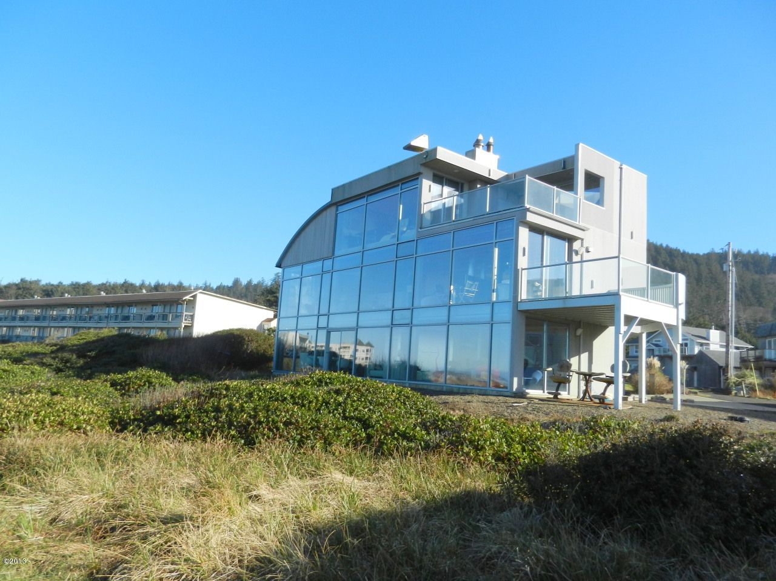
In 2005, the Ellisons borrowed $1,000,000 from a local Oregon bank
Notes:
In 2005, the Ellison’s borrowed $1,00000,000 on their little beachfront bungalow from a local Oregon Bank (that was in Portland). The fact that the bank was in Portland later becomes somewhat important. This is a picture of the actual house: Three stories, an elevator and about 4500 square feet.
-click-

Slide 76
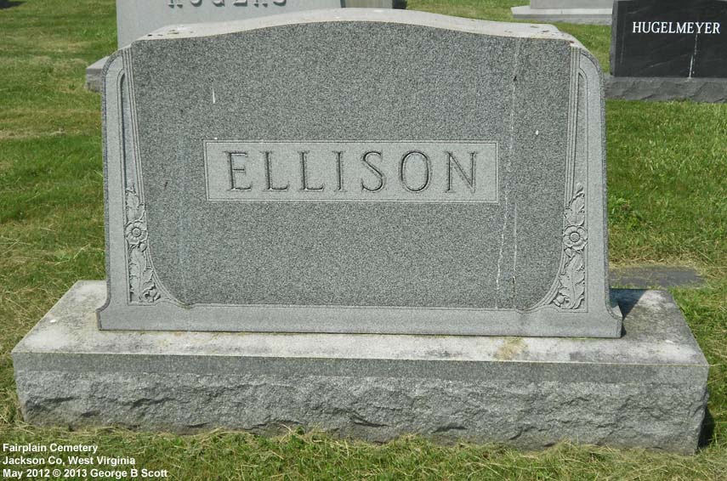
In 2009 David Ellison died
Notes:
In 2009, David Ellison passed away. Of course, all of the interest in the Oregon beach house goes to his wife Edith. But remember, they had children that lived in the NW who had convinced them to buy their house in 1998.
-Click-

Slide 77

In 2010, Edith conveyed the property to Under the Sea LLC, an Arizona limited Liability company
Notes:
In 2010, Edith conveyed the property to an Arizona LLC called “Under The Sea LLC. Edith and her late husband had numerous LLCs in Arizona. This one happened to be made up of Edith and her son Joe. I later found it interesting that “Under the Sea” is a lot like “Underwater”!
-Click-

Slide 78
In July of 2012, the bank commenced a judicial foreclosure proceeding
Notes:
In July of 2012, the bank started a judicial foreclosure action. The complaint stated that there was now owing $1.3 million dollars on that original $1,000,000 loan! Hmmm, now the “under the sea” thing is starting to make sense!
Click

Slide 79

Under the Sea LLC and Edith gives a Deed in Lieu to the bank
Notes:
Six months later, in January of 2013 “Under the Sea” LLC as current owners of the property and Edith as an individual gave a DIL to the bank. The DIL was signed by both Edith, individually and by Edith and her son Joe as members – so there was really no issue there.
Click

Slide 80
Notes:
The bank then put the house on the market. The original asking price was $750,000. Remember, this was a very nice, very modern and very large ocean front home

Slide 81
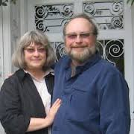

Eighteen months later, the bank sold the property to the Cooks for $550,000 cash
Notes:
18 months later, the bank finally sold the property to a couple from Kennewick, Washington for $550,000. Brand X insured the new owners who were obviously thrilled with their “find” After all, they just bought a million dollar summer home for half price!

Slide 82
Are there any concerns??
The bank started a foreclosure, but the owners gave a deed in lieu
The owners were an LLC, but member was original owner.
Prior owner that gave the DIL was a “sophisticated” borrower
The new out of state owners paid cash for the property and got a heck of deal!
Notes:
Are there any concerns up to this point? Let’s take a look….
Click
The bank started a foreclosure action, but the owner of the property gave them a deed in lieu
Click
The owners were an LLC, but one of the members was the original owner/borrower who also signed individually
Click
Also, the prior owner that gave the deed in lieu was a sophisticated borrower. Remember she and her deceased husband were successful commercial realtors in Arizona who owned numerous properties , were developers and had a number of LLCs that held title ro property. And again, Grandma signed not only as a member of the LLC, but as an individual as well
Click
The new owners were thrilled with their “million dollar home”. They got a heck of deal AND they paid cash and took it off the banks hands.
Nothing too unusual so far…

Slide 83
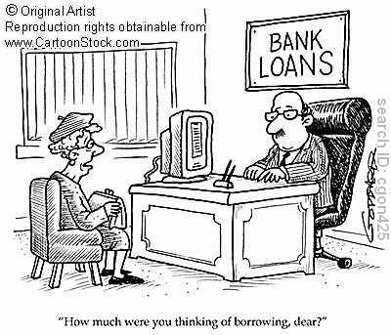
An order comes in from a new lender for a reverse mortgage for $550,000
But the borrower is the original owner!?
Five days after the order is opened, a deed records from the nice couple that bought the property from the bank to the original owner….
Notes:
Here’s where if gets interesting: An order comes in from a new lender requesting title insurance for a reverse mortgage for $550,000 – remember this property was purchased for $550,000 and the buyers paid cash! Also, they lived in another state and this was a their summer home. Are they moving to the coast??
Click
But the new lender is saying that the original owner is the borrower – again, what is going on, something is out of whack
Click
Then 5 days after the order is opened, a deed records from the nice couple that bought the property from the bank to Mrs. Ellison – the original owner! By the way, that deed recorded exactly one year to the day after they bought it from the bank.
Click

Slide 84
The bank was a local Oregon Bank, but their office was in Portland
They agreed to let Mrs. Ellison remain in the house until they sold it
“New Buyers” were looky loos - they really had no intention of buying anything
Mrs. Ellison pulled them aside and made them a deal they couldn’t refuse……
Notes:
And now the rest of the story
Click
Even though the bank was a “local” Oregon Bank, their office was in Portland. The house is in a small coastal town several hundred miles way – they wanted someone in the house that would take care of it;
Click
So they agreed to let Grandma stay in the house until it was sold – which she was more than happy to do
Click
One day a couple from Washington came by to look at the “bank owned property”. They were just looking and had no intention of buying anything
Click
But while they were in the house “looking”, Grandma Ellison pulled them aside and made them a deal they couldn’t refuse. She offered to pay them $5000 if they would buy it from the bank. She would give them all of the money to buy the house with an agreement to deed the property to her after one year! They agreed.

Slide 85
We refused to insure without consent
Granny just got her house back for $550,000 (plus the $5,000 she paid to the Cooks), though she previously owed the bank $1.3 million on the house– wiping out a debt of more than a whopping $750,000!!
Notes:
When we saw the new deed, we refused to insure the new loan without consent and acknowledgement from the bank that took it back
Click
Click
Remember, Grandma just got her house back for $550,000 – plus the $5,000 she paid to the Cooks even though she had previously owed the bank $1.3 million! She just wiped out a debt of more than $750,000 on her home!
Her attorney argued and argued that it was her house and she had the right to borrower on it or do whatever else she liked with it. We asked him to provide us a letter from the bank acknowledging that Mrs. Ellison was the “new” owner and that she had financed the Cooks so they could “buy” the property. He not only refused, but said that he absolutely did not want the bank to know about it! He also was adamant that we were not to say anything about this to the new lender…
In a letter that he then sent trying to convince us to insure, he said that, in his opinion, there was only about a 30% chance that the original lender would sue and that should be good enough for us!

Slide 86

We refused to insure –we didn’t like the “odds”
Brand X took the order and insured it
Six months later the bank filed suit against Mrs. Ellison, the Cooks and the new insured lender…..
Notes:
So how did it all turn out? Click First we refused to insure. We didn’t like the “odds”!
Click
And just like the claim with grandpa the rodeo clown, they took the order to Brand X and said nothing about the “issues”. Brand X cheerfully took the order and insured the new mortgage. I don’t know if they didn’t realize what had happened or if they wanted a “big” order. After all, a $550,000 order was a big deal in an area where most houses were selling for around $100,000….
Click
But 6 months later, the bank filed suit against Grandma, the new lender, the Cooks and the title company…That suit is still pending….We were lucky that we had an alert title examiner to thank for saving us from a claim. She really didn’t know what was wrong, but knew something was and started asking all the right questions…
___________________________________________________________________
These are just a handful of claims that I hope we can all learn from. My personal philosophy is if we are alert, use good common sense and do the right thing, we can avoid getting ourselves into about 90% of the claims. The other 10% - well they are going to be out there….

Slide 87

I will leave you with this last real claim…
“ My neighbor stands naked on her balcony and fires a shotgun in the air whenever someone drives down the road to visit me.”
Notes:
I will leave you with this one last real claim
CLICK
My neighbor stands naked on her balcony and fires a shotgun in the air whenever someone drives down the road to visit me
CLICK
We turned it down

